Slide 1

Advanced Data Driven Marketing for Optimizing Business's Marketing ROIs
Advanced Data Driven Marketing for Optimizing Business's Marketing ROIs
By
N.Varun Reddy
N.Vyshnavi
By
Xyz
pqr

Slide 2

Agenda
1.
Introduction
Data Description, Literature Review and Research Process
2.
EDA Details
Key Data Trends and Insights
3.
Next Steps
Machine Learning Model Selection and Expected Outcomes

Slide 3
Agenda
1.
Introduction
Problem Definition, Data Description and Research Process
2.
EDA Details
Key Data Trends and Insights
3.
Next Steps
Machine Learning Model Selection and Expected Outcomes

Slide 4
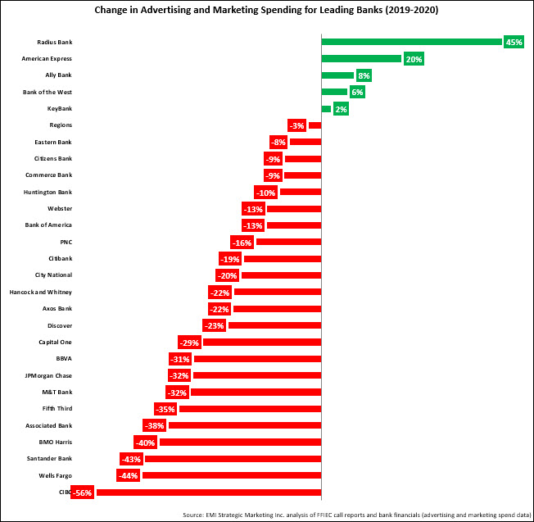
Introduction
Marketing is a great tool for most of the businesses for boosting sales. It is an important function in any business as production and distribution largely depend on marketing success
With the growth of technology and digital marketing, traditional marketing channels like direct telemarketing etc., are failing to capture business attention
One the major reason for this is the swift change in business operations as well as customer needs.
Advent of Covid in 2020 is demanding more returns from marketing activities with limited or reduced budget across businesses.
Data driven campaign management is the only option for business under these circumstances for Optimizing revenue generated from marketing campaigns.
Figure showing the decline of marketing budgets (between 2019-2020) across major banks in Banking industry Source: https://emiboston.com/banks-cut-marketing-spend-in-2020-but-expect-to-ramp-up-investment-in-2021/

Slide 5
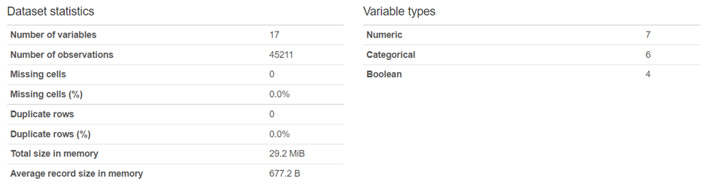
Dataset Description
Columns | Description
age | Age of customer
job | Type of job
marital | Marital status
education | Education of Customer
default | Has credit in default?
housing | Has housing loan?
loan | Has personal loan?
contact | Contact communication type
month | Last contact month of year
day_of_week | Last contact day of the week
duration | Last contact duration, in seconds (numeric)
campaign | Number of contacts performed during this campaign and for this client
pdays | Number of days that passed by after the client was last contacted from a previous campaign
previous | Number of contacts performed before this campaign and for this client
poutcome | Outcome of the previous marketing campaign
Source
https://archive.ics.uci.edu/ml/datasets/Bank+Marketing#
Summary

Slide 6
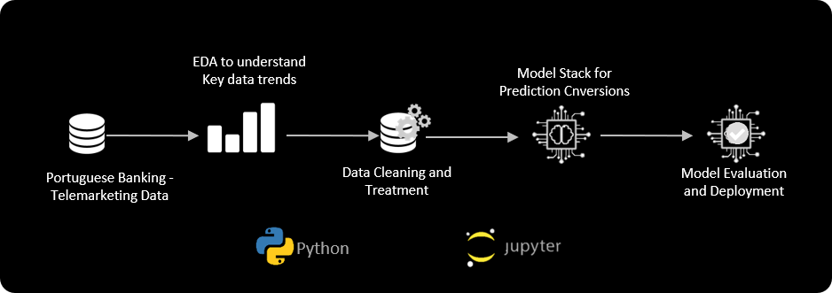


Research Process and Solution Architecture
Problem Exploration & Business Understanding
Business Understanding
Data Gathering
Exploratory Data Analysis
Data Wrangling
Model Development
Model Validation & Deployment

Slide 7
1.
Introduction
Data Description, Literature Review and Research Process
2.
EDA Details
Key Data Trends and Insights
Univariate Analysis
3.
Next Steps
Machine Learning Model Selection and Expected Outcomes

Slide 8
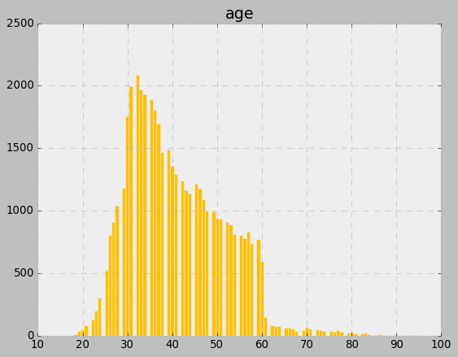
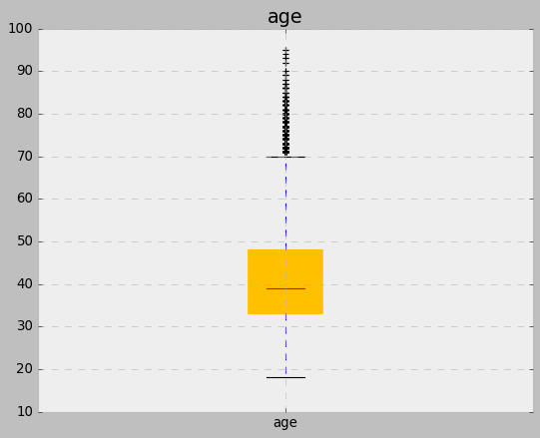
Univariate Analysis
Feature: Age
Data Type: Float
EDA Insight: Majority of the customer are with age <60 with the distribution loosely following normal distribution. Outlier are observed and no missing values

Slide 9
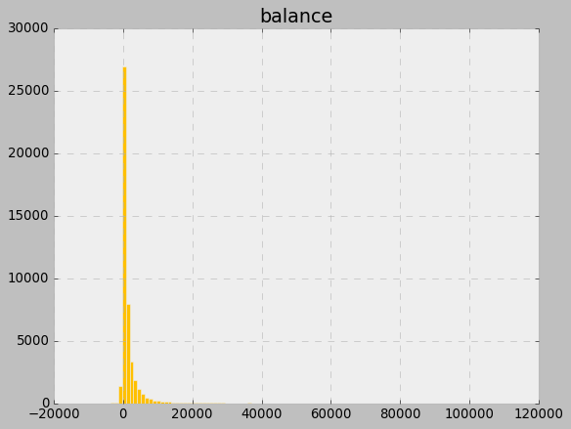
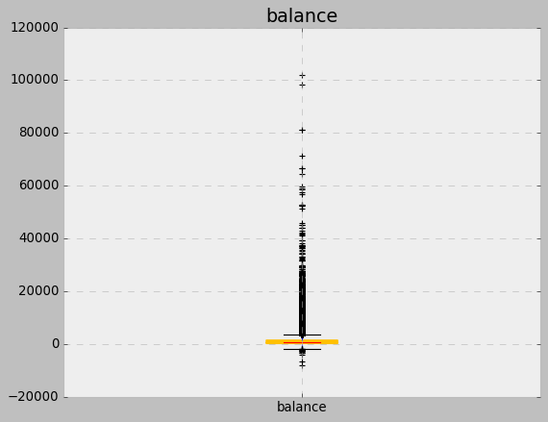
Univariate Analysis
Feature: Balance
Data Type: Float
EDA Insight: Balance of the customers is following a left skewed distribution. Outlier are observed with negative balance and a high balance and no missing values

Slide 10
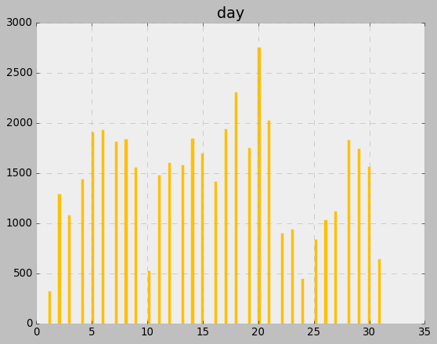
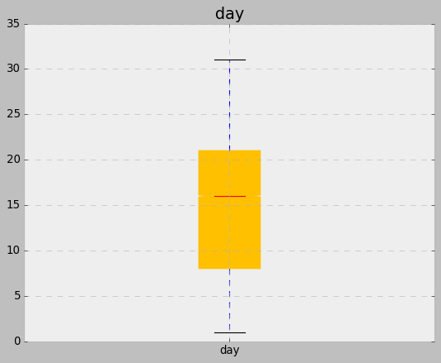
Univariate Analysis
Feature: Day
Data Type: Int
EDA Insight: Day of the month feature is loosely following a constant distribution with marketing activity more or less same across all days of month except from 20th to 25th . No outlier/no missing values observed

Slide 11
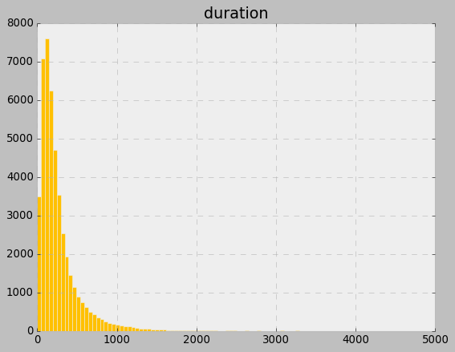
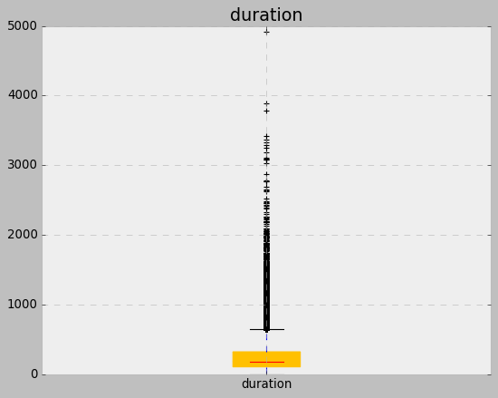
Univariate Analysis
Feature: Duration
Data Type: Int/Float
EDA Insight: Call duration is following a right skewed distribution with majority of calls ending in <500 sec . Outlier are observed and no missing values

Slide 12
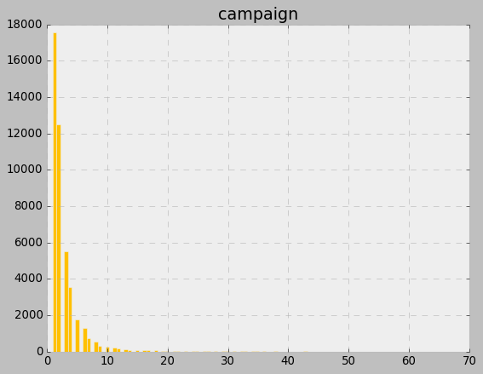
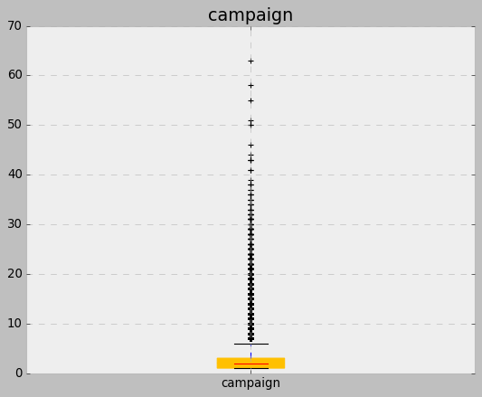
Univariate Analysis
Feature: Campaign
Data Type: Int/Float
EDA Insight: Call duration is following a right skewed distribution with an average of 2.5 contacts per customer during campaign period. Outlier are observed and no missing values

Slide 13
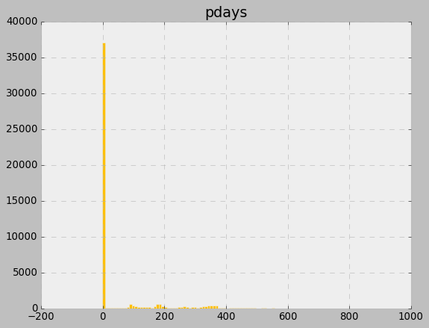
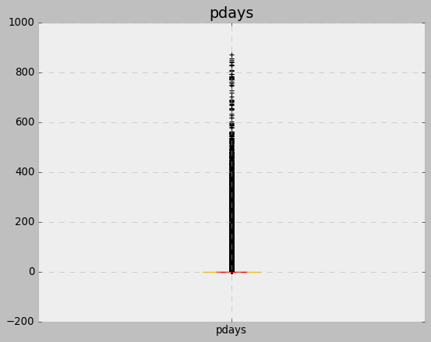
Univariate Analysis
Feature: Pdays
Data Type: Int
EDA Insight: Majority of the customers (81.7%) are not contacted again during a campaign. Outlier are observed and no missing values
81.7% of customer have pdays as -1

Slide 14
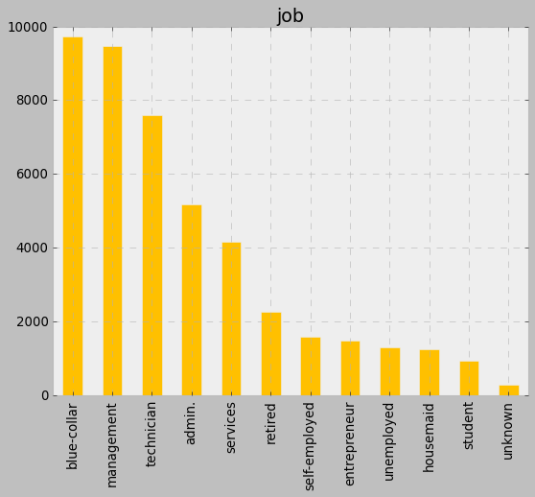
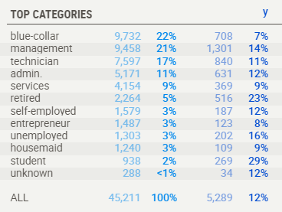
Univariate Analysis
Feature: Job
Data Type: String (Categorical)
EDA Insight: Blue-collar, Management, Technician and Admin are the major job types with more than 71% records. Interestingly student and retired (both the ends of age distribution) are more likely to opt for term plan

Slide 15
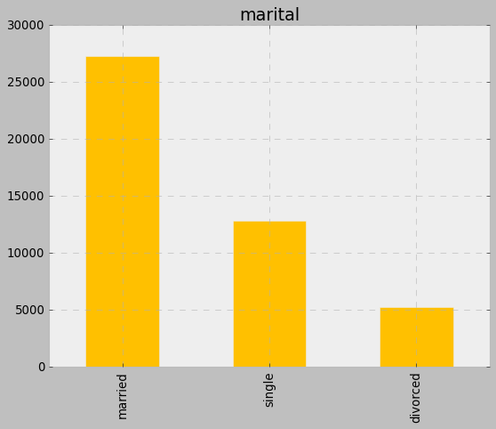
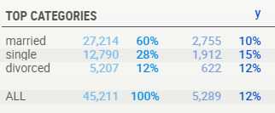
Univariate Analysis
Feature: Marital
Data Type: String (Categorical)
EDA Insight: Divorced and Sigle customers are more likely to opt for term plan

Slide 16
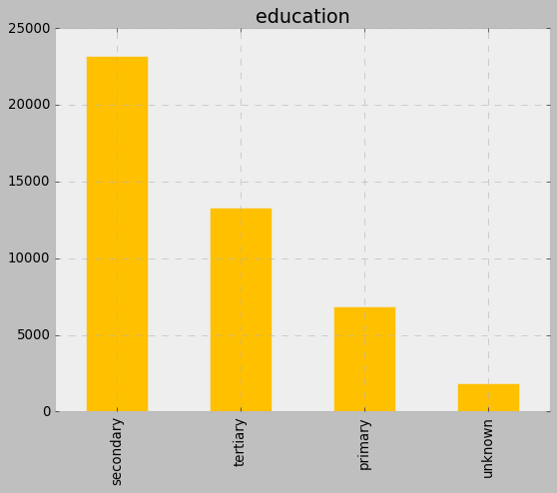
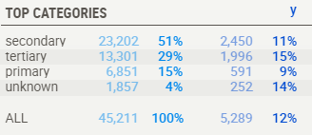
Univariate Analysis
Feature: Education
Data Type: String (Categorical)
EDA Insight: Majority of the customers are having secondary education followed by tertiary and primary

Slide 17
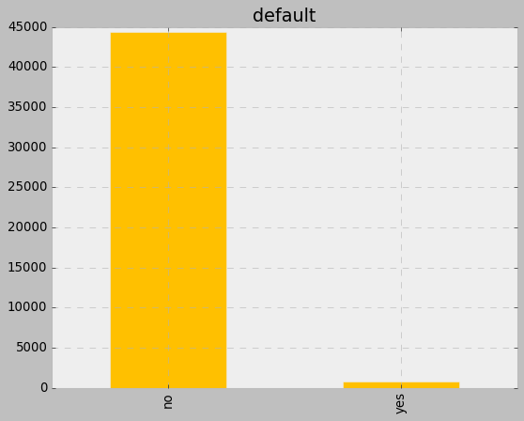
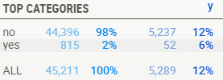
Univariate Analysis
Feature: Default
Data Type: String (Categorical)
EDA Insight: As expected majority of the customer are non defaulters and non-defaulters are more likely to opt for term deposit

Slide 18
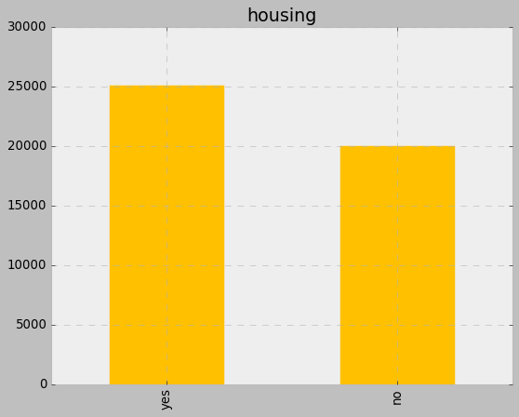
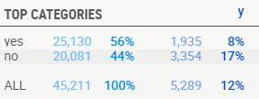
Univariate Analysis
Feature: Housing
Data Type: String (Categorical)
EDA Insight: Customer base is more or less equally split between people owning house and without owning house. Customers with house are more likely to go for term deposit, this kind of aligns with idea that people with house might have existing loans as well people without house might plan savings in term plan for buying house

Slide 19
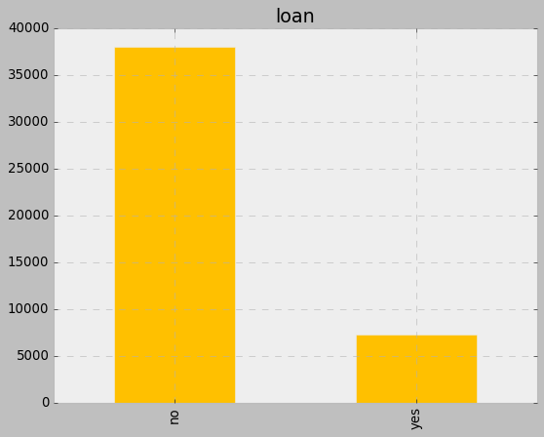
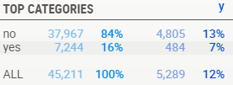
Univariate Analysis
Feature: Loan
Data Type: String (Categorical)
EDA Insight: Majority of the customer doesn’t have an existing loan and customers without loans are more likely to opt for term plan

Slide 20
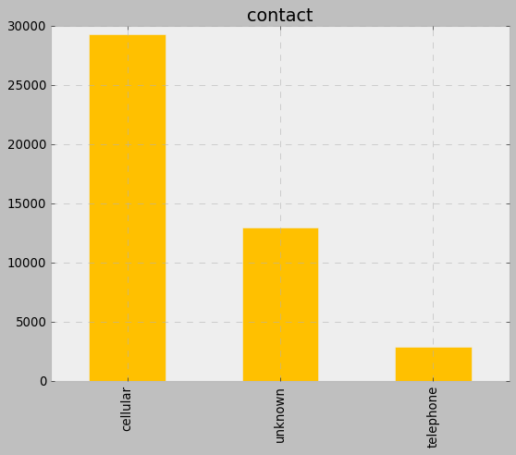
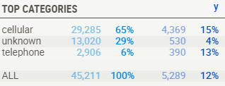
Univariate Analysis
Feature: Contact
Data Type: String (Categorical)
EDA Insight: Contact type for a good chunk (~30%) of customers is unknow

Slide 21
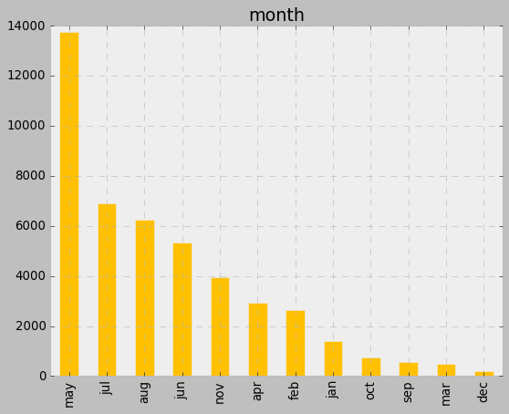
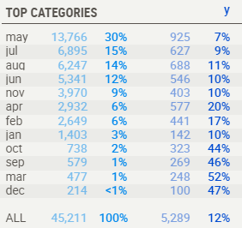
Univariate Analysis
Feature: Month
Data Type: String (Categorical)
EDA Insight: Sep, Oct and Dec months show a we high decline in marketing activity. Interestingly months with low activity are experiencing better conversion rate but this can be majorly due to baseline or organic flow of term deposits rather than from marketing activity

Slide 22
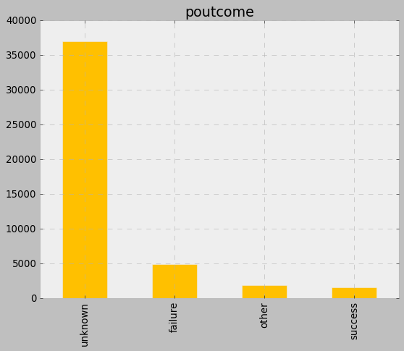
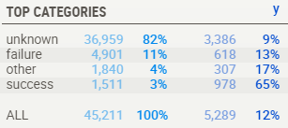
Univariate Analysis
Feature: poutcome
Data Type: String (Categorical)
EDA Insight: Poutcome for majority of the customer is unknown this can be due to the fact that majority of the customer prioritized for current campaign are not targeted previously (refer to distribution for “previous trend”

Slide 23
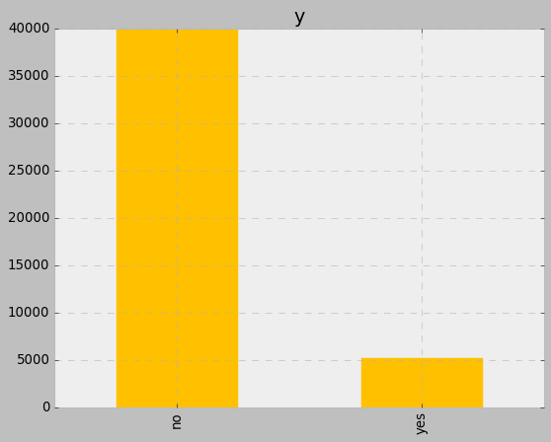
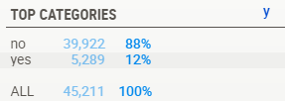
Univariate Analysis
Feature: y
Data Type: String (Categorical)
EDA Insight: Only 12% of the campaign activity has success. This low class ratio might cause the problem of class imbalance. Appropriate techniques have to implemented to address the same.

Slide 24
1.
Introduction
Data Description, Literature Review and Research Process
2.
EDA Details
Key Data Trends and Insights
Multivariate Analysis
3.
Next Steps
Machine Learning Model Selection and Expected Outcomes

Slide 25
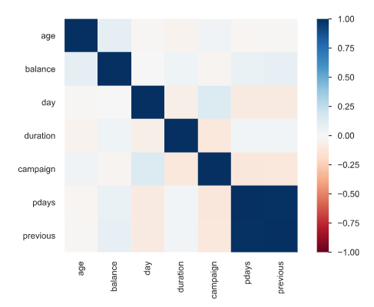
Multivariate Analysis – Numerical (Indept. vs. Indept. Vars)
EDA Insight:
Pdays and previous features are very highly correlated. Due to very high correlation one of these features can be eliminated
Spearman's ρ
The Spearman's rank correlation coefficient (ρ) is a measure of monotonic correlation between two variables, and is therefore better in catching nonlinear monotonic correlations than Pearson's r. It's value lies between -1 and +1, -1 indicating total negative monotonic correlation, 0 indicating no monotonic correlation and 1 indicating total positive monotonic correlation. To calculate ρ for two variables X and Y, one divides the covariance of the rank variables of X and Y by the product of their standard deviations.
Variable Correlation

Slide 26
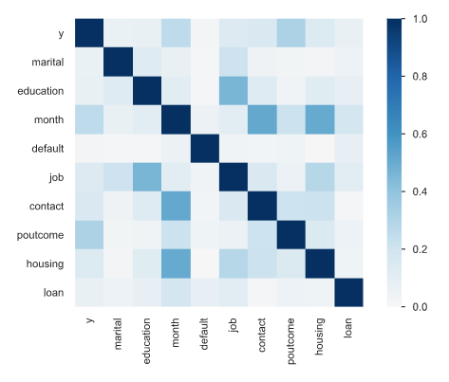
Multivariate Analysis – Categorical (Indept. vs. Indept. Vars)
EDA Insight:
Variable month is correlated with contact and housing but this correlation cannot be explained in business terms
Variable job is correlated with education which is an expected outcome
Poutcome and month are correlated with target variable which might important feature for modelling
Need to be cautious while understanding correlation of month with target as seen in the previous univariate analysis correlation might just be due to baseline of term deposit creation coupled with low activity
Cramér's V (φc)
Cramér's V is an association measure for nominal random variables. The coefficient ranges from 0 to 1, with 0 indicating independence and 1 indicating perfect association. The empirical estimators used for Cramér's V have been proved to be biased, even for large samples
Variable Correlation

Slide 27
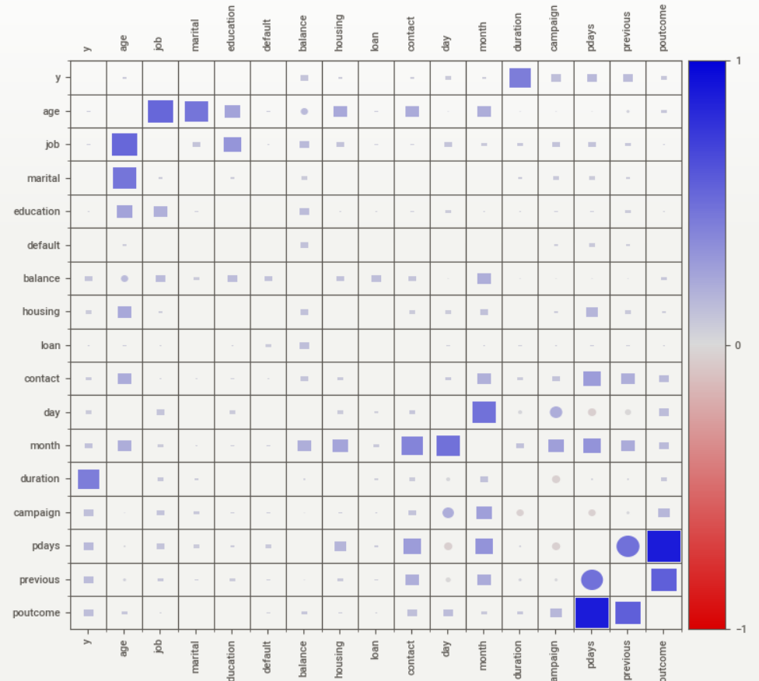
Multivariate Analysis – All Var with Target
EDA Insight:
Duration seems to a highly influential variable for outcome prediction. This kind of align with the fact that if customer is interested in the idea of term deposit then only he will engage in conversation with the agents
Other variables exhibiting influence on target variable are campaign, pdays, previous and poutcome
Similar to education and job, age is correlated with job
■ Squares are categorical associations (uncertainty coefficient & correlation ratio) from 0 to 1. The uncertainty coefficient is assymmetrical, (i.e. ROW LABEL values indicate how much they PROVIDE INFORMATION to each LABEL at the TOP). • Circles are the symmetrical numerical correlations (Pearson's) from -1 to 1. The trivial diagonal is intentionally left blank for clarity.

Slide 28
1.
Introduction
Data Description, Literature Review and Research Process
2.
EDA Details
Key Data Trends and Insights
3.
Next Steps
Machine Learning Model Selection and Expected Outcomes

Slide 29
Summary and Next Steps
Overall data shows no sign of missing values hence no missing value treatment is needed
Certain numerical feature like Age, Balance etc., shows outlier values. If outlier sensitive models like logistic regression are using for modeling data then outlier treatment is necessary
Though initial observation of correlations showed that feature like duration, poutcome, loan etc., shows better capability explaining target variable other variable selection technique like feature important etc., will be used for final variable selection
Target out of 100% of customers/records only 12% are opting for term deposit. This low class ratio might hinder model learning capability due to with class balancing techniques would be required for better modeling

Slide 30
Suggested Modeling Technique based on EDA Observations
As data shows a good mix of categorical and continuous variable along with good amount of outlier values techniques like Decision Tree, Random Forest, Adaboost and Xgboost needing less data treatment can be tried
Though lot of variables show skewed distribution logistic regression with appropriate variable transformation, for normalization, can be tried and used as a baseline model
Due to the presence of good number of categorical variables and need for dummy coding might results in high variable dimensionality due to which SVM can worth trying out
Due to presence of slight class imbalance if modelling on as-is data doesn't provide better F1 Score and Precision class balancing techniques like Over sampling, Under sampling and SMOTE can be deployed
No experimentation on deep learning models will be performed as one of the business objective include model interpretability for better actionability and strategy planning
Deep learning models being black box lack explainability

Slide 31
Thank You

